Slide 1

WAY TO ENTERPRISE
Spring Framework

Slide 2
Agenda
Anotation Mapping
Copyright © VTI Academy All Rights Reserved

Slide 3
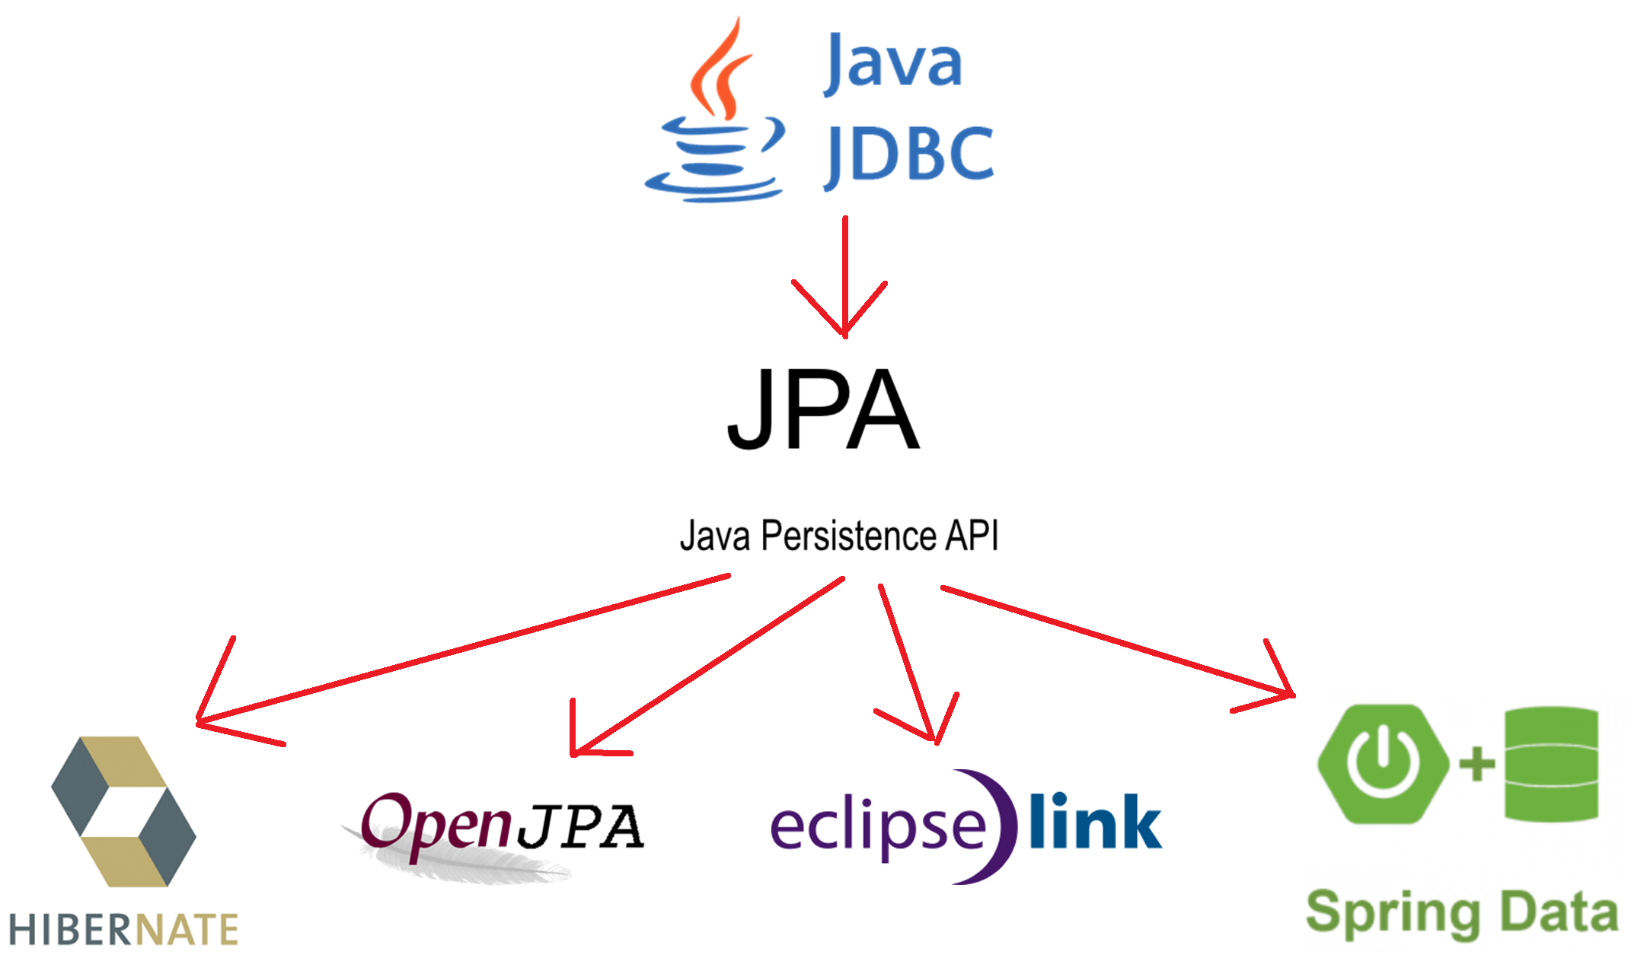
Connecting Database Libraries

Slide 4
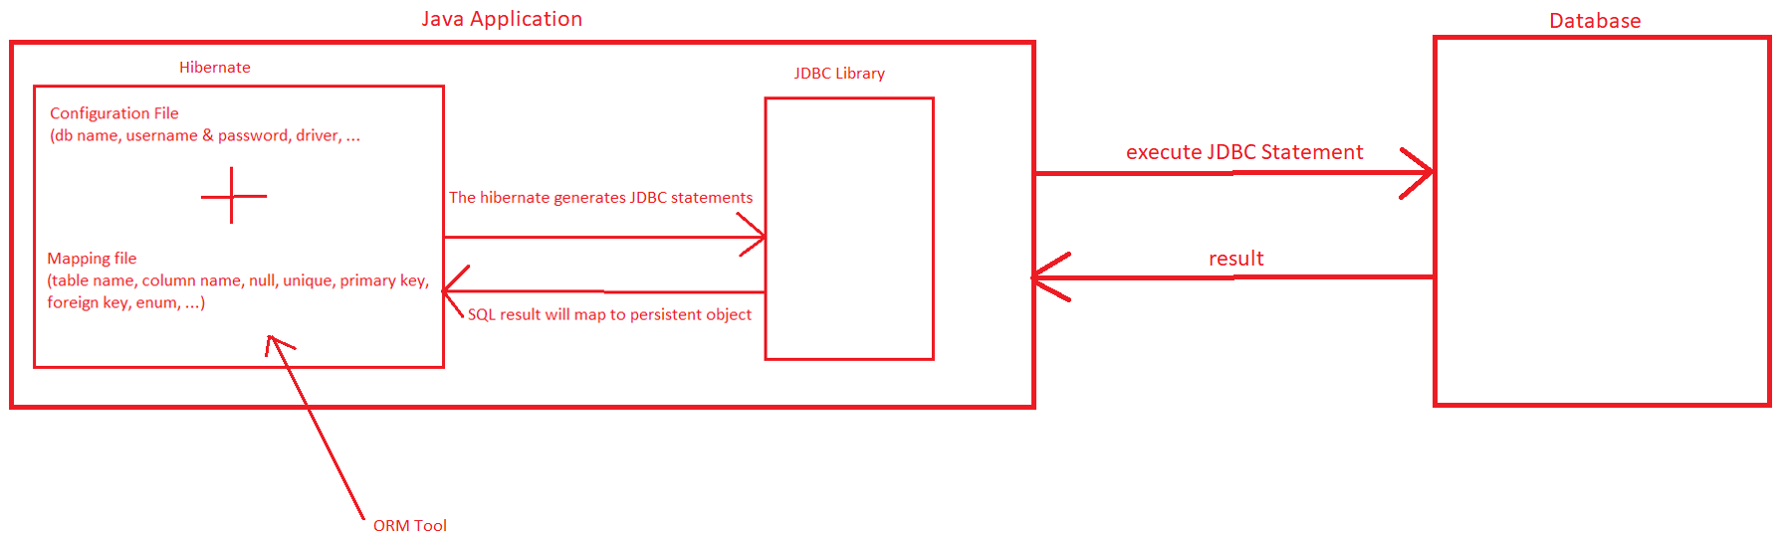
ORM Tool
Stands for Object Relational Mapping
Simplifies the data creation, data manipulation and data access.
ORM is a programming technique that maps the object to the data stored in the database.

Slide 5
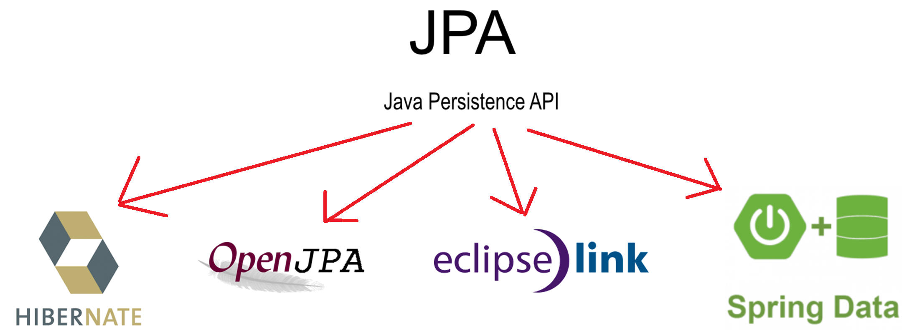
JPA
Java Persistence API (JPA) is a Java specification that provides certain functionality & standard to ORM tools

Slide 6
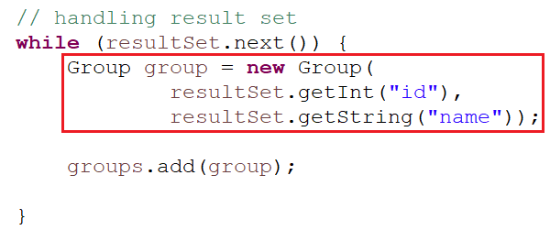
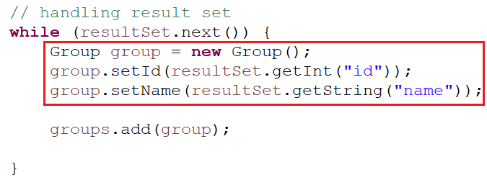
Persistent object
Persistent Object (Plain Old Java Object - POJO)
Require:
  A no-arg constructor
  Have a id property as primary key in database’s table
  Declare getter and setter methods
  Non-final class
JDBC
Hibernate

Slide 7
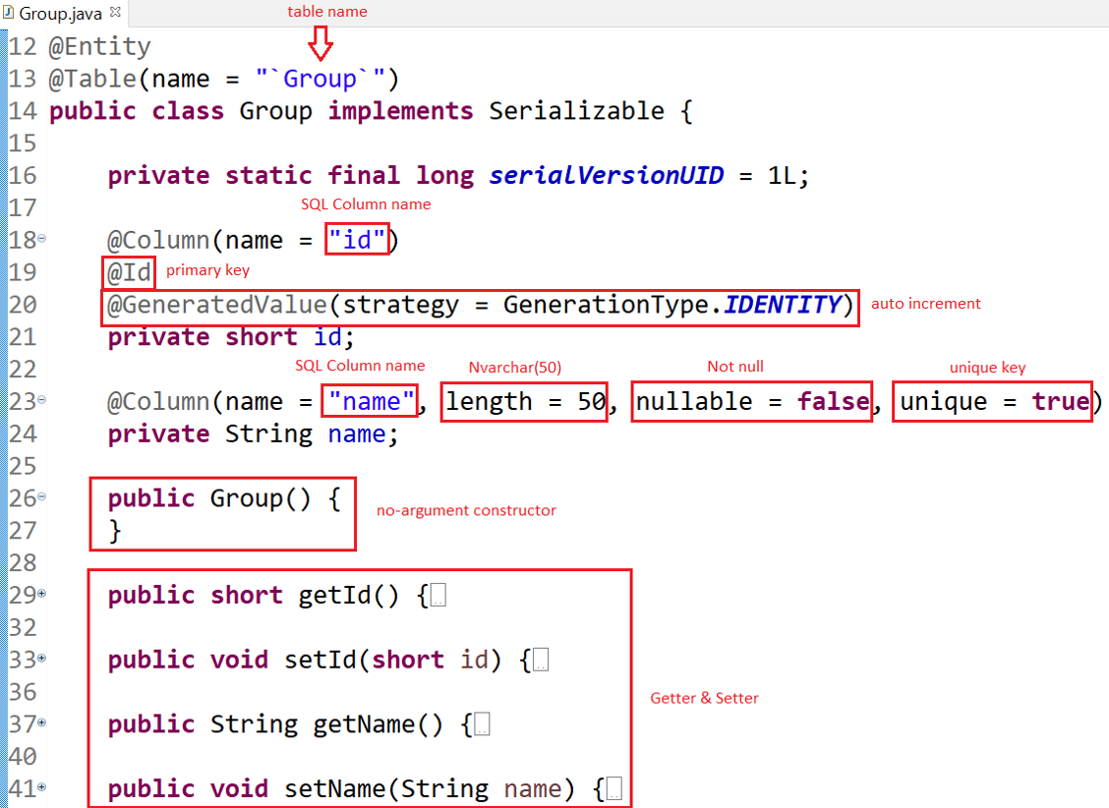
Mapping File
Config by:
  annotation
Config by annotation

Slide 8
Annotation Mapping
Primitive type
Date & DateTime
Enum
@Table, @Column, @Formula, Default value, @PrePersist

Slide 9
Annotation Mapping
Primitive type
Java | Database
short (Short) | TINYINT
short (Short) | SMALLINT
int (Integer) | INT
long (Long) | BIGINT
float (Float) | FLOAT
double (Double) | DOUBLE
BigDecimal | DECIMAL
String | CHAR, VARCHAR, NCHAR, NVARCHAR, TEXT
boolean (Boolean) | BIT

Slide 10
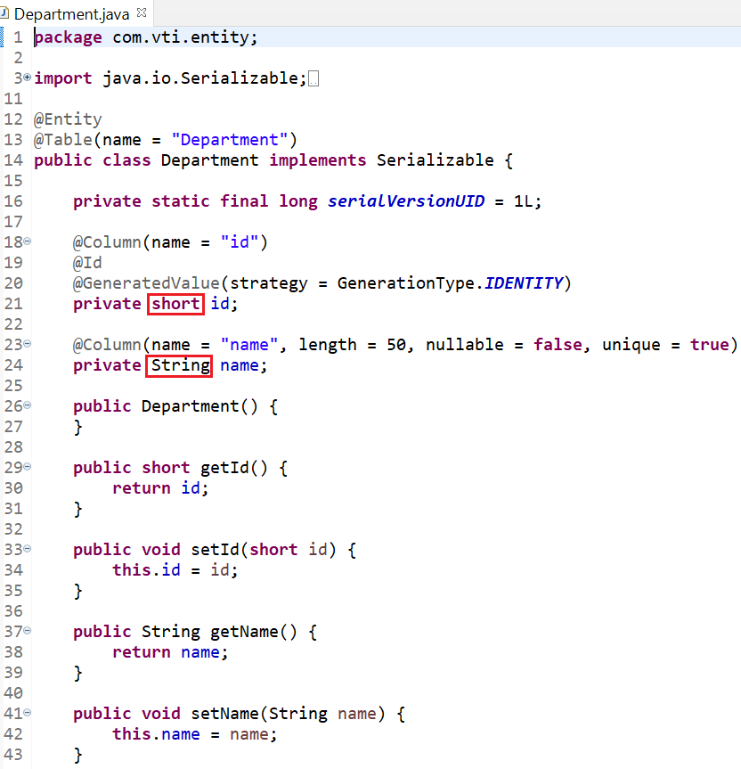
Example
Entity

Slide 11



Annotation Mapping
Date & DateTime
Java | Database
@Temporal(TemporalType.DATE) | Date
@Temporal(TemporalType.TIME) | Time
@Temporal(TemporalType.TIMESTAMP) | DateTime
java.util.date
Tutorial: https://www.baeldung.com/hibernate-date-time

Slide 12
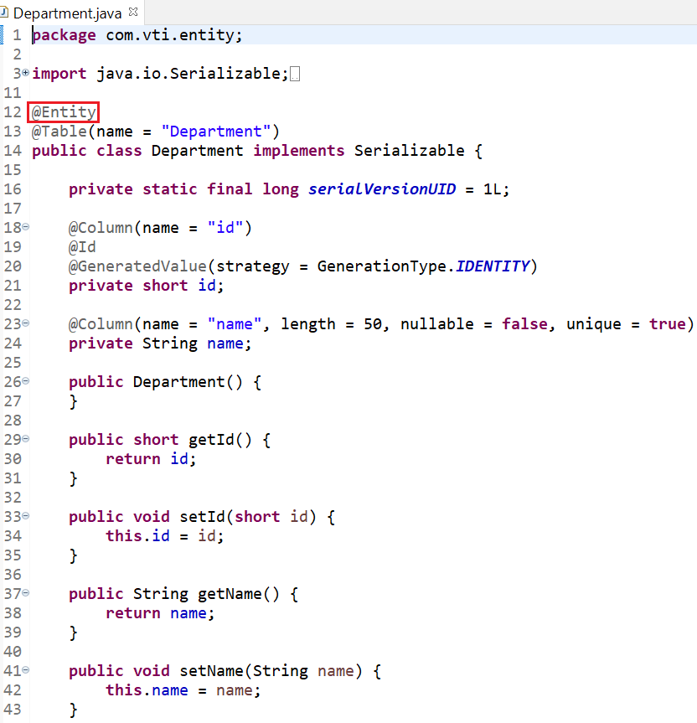
Annotation Mapping
@Entity: Define class which has @Entity is a Database’s table

Slide 13
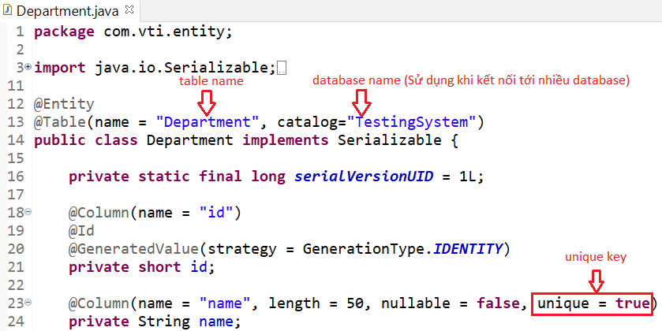
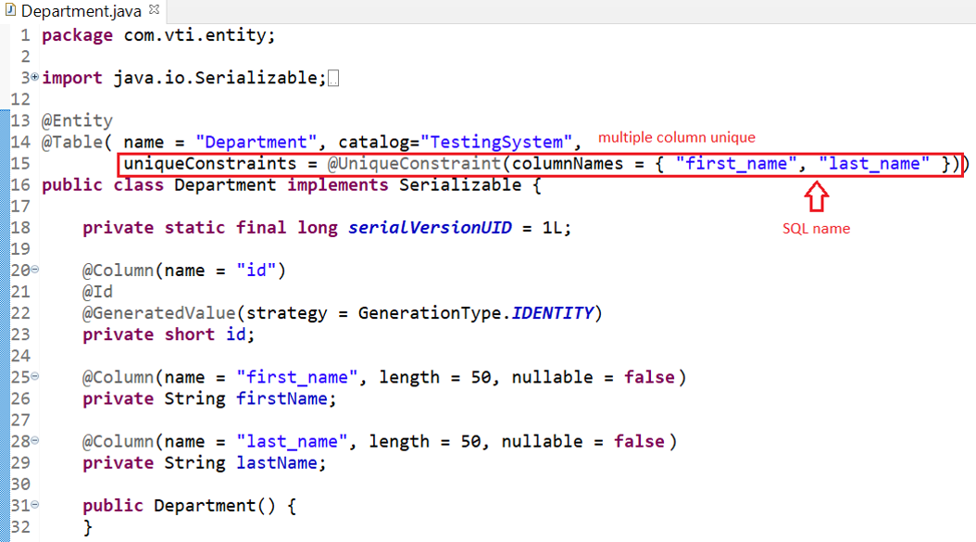
Annotation Mapping
@Table
  name: table’s name
  catalog: database’s name
  uniqueConstraints: config multiple column unique

Slide 14
Annotation Mapping
@Column
  name: column’s name
  length: varchar has default 255
  nullable: field is configed null or not null
  unique: field is configed unique or not unique
  insertable: we can insertable this field into database (default = true)
  Ex insertable = false: id, created_date, ...
  updatable: we can updatable this field into database (default = true)
  Ex updatable = false: id, account, created_date, ...
  columnDefinition: set default value

Slide 15
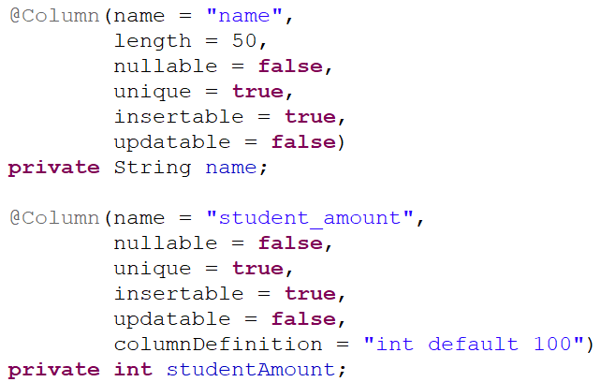
Annotation Mapping

Slide 16
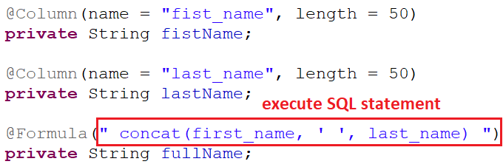
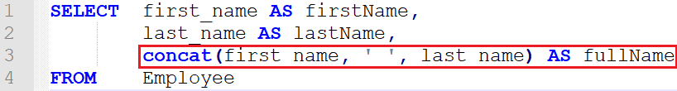
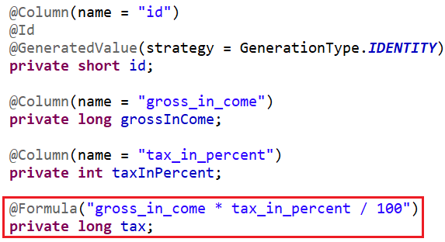
Annotation Mapping
@Formula: Fake field (logic property)

Slide 17
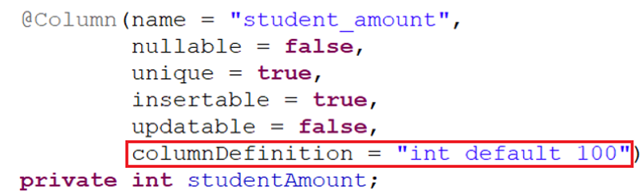
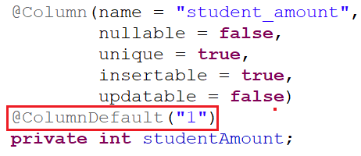
Annotation Mapping
Default value

Slide 18
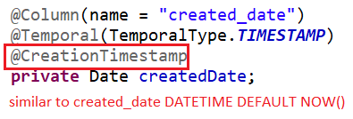
Annotation Mapping
Default Date

Slide 19
Enum
2 ways
  Using @Enumerated
      Ordinal value
      String value
  Using @Converter

Slide 20
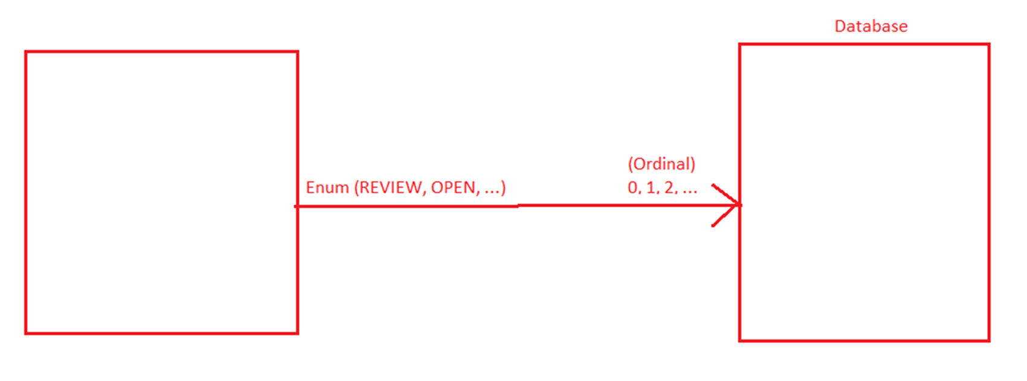
Enum
Ordinal value

Slide 21
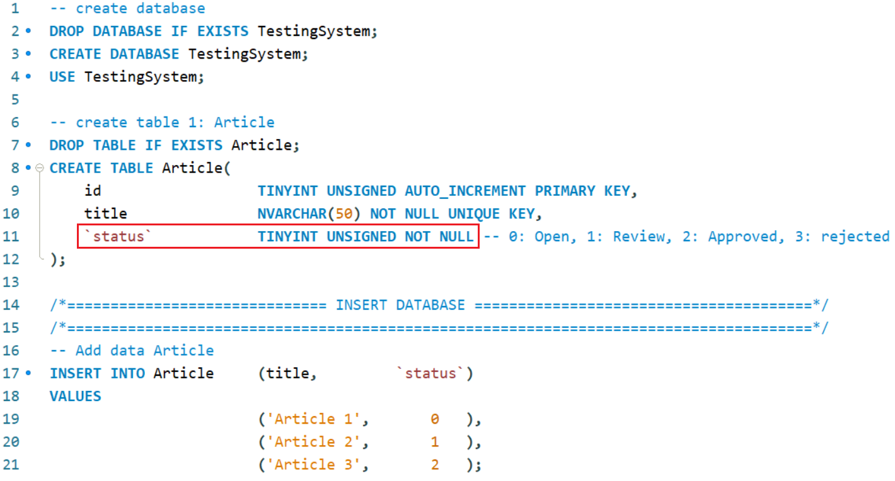
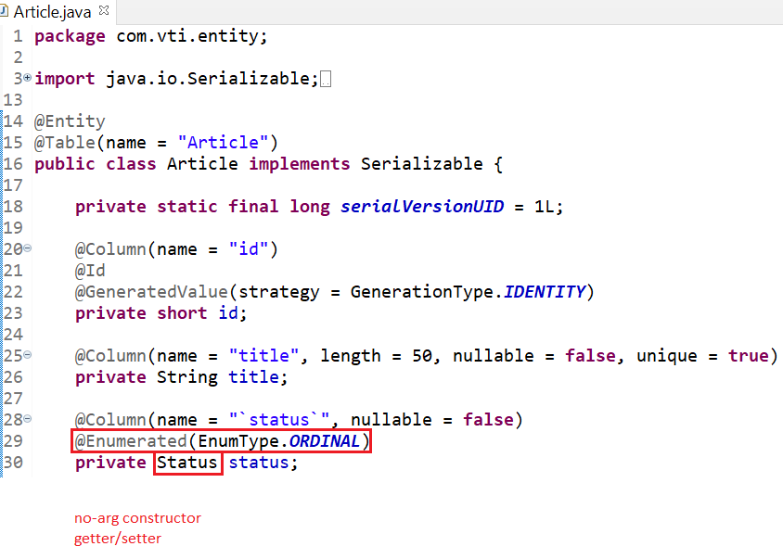

Enum
Entity
Enum

Slide 22
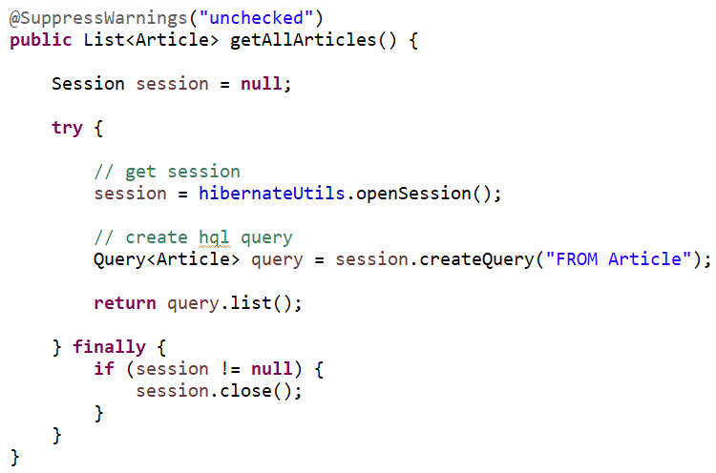
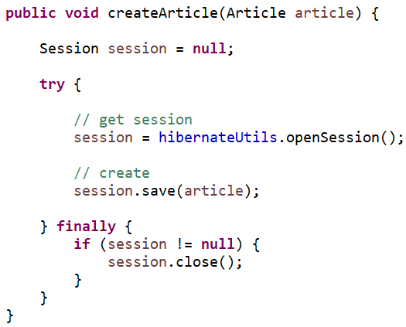
Enum
Repository

Slide 23
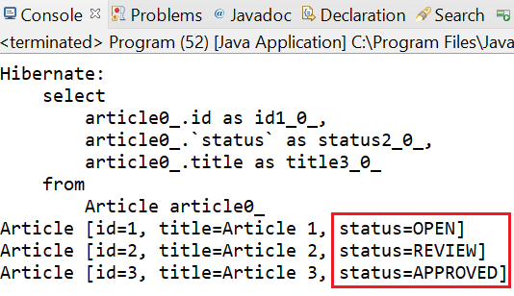
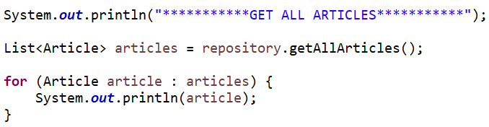
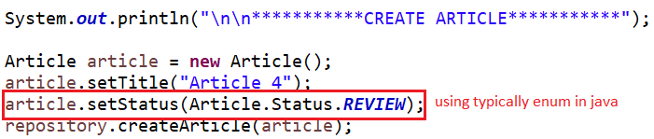
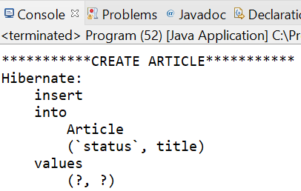
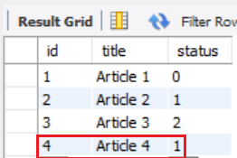
Enum
Mapping enum in Java
REVIEW (in Java) → 1 (in SQL)

Slide 24
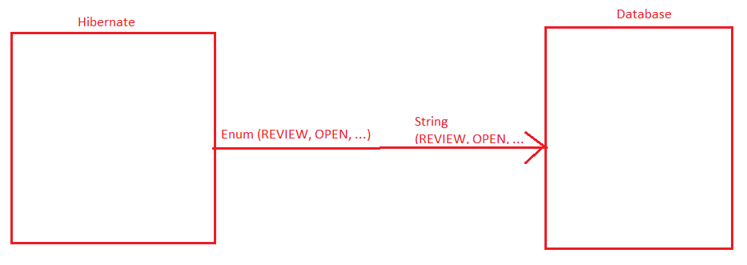
Enum
String value

Slide 25
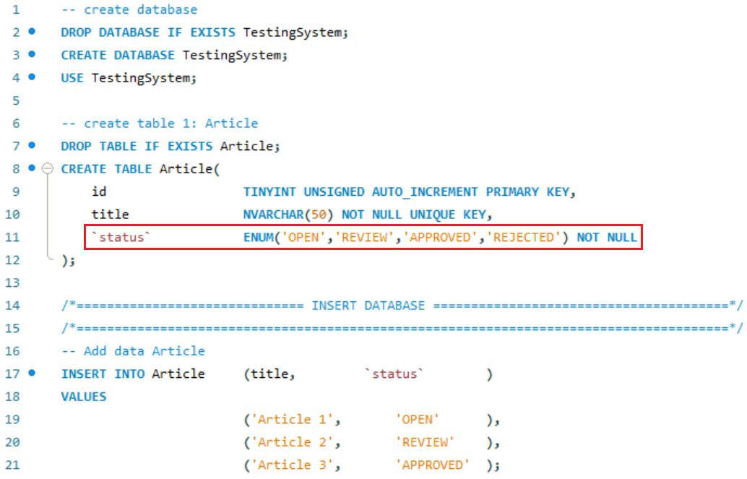
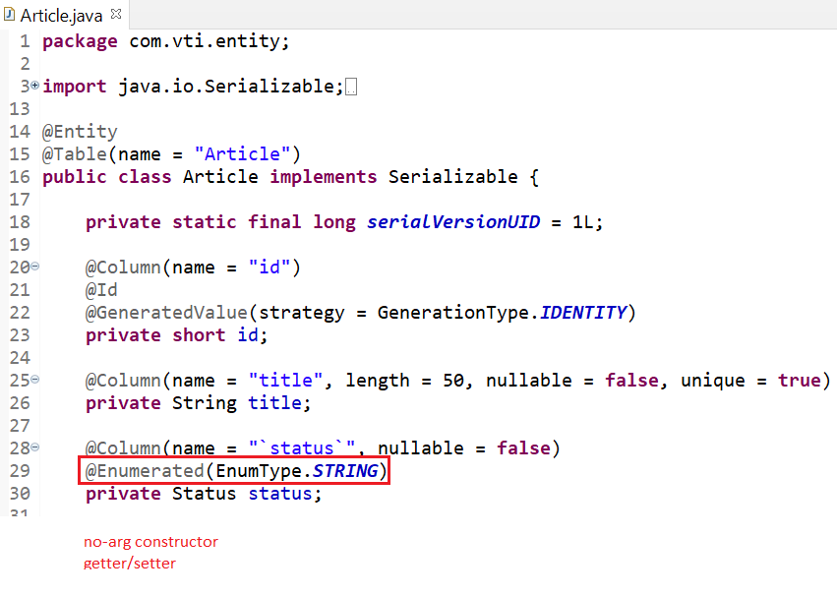
Enum
Entity
Enum

Slide 26
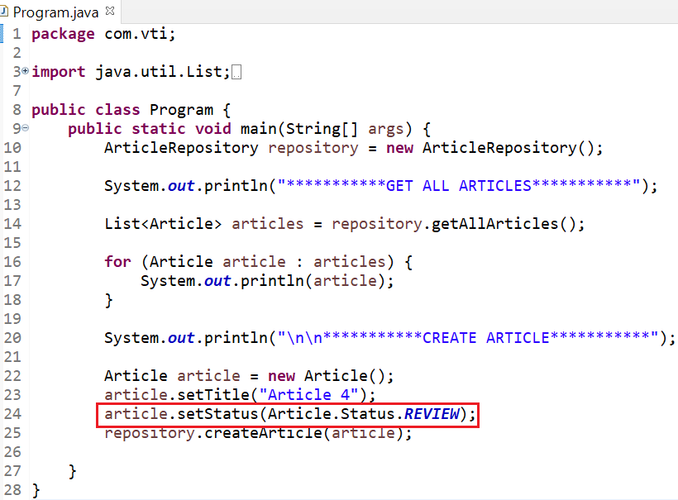
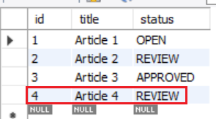
Enum
REVIEW (in Java) → REVIEW (in SQL)

Slide 27
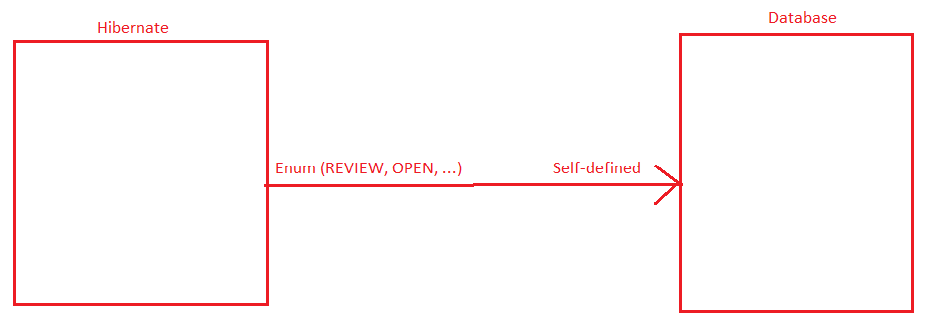
Enum
@Converter

Slide 28
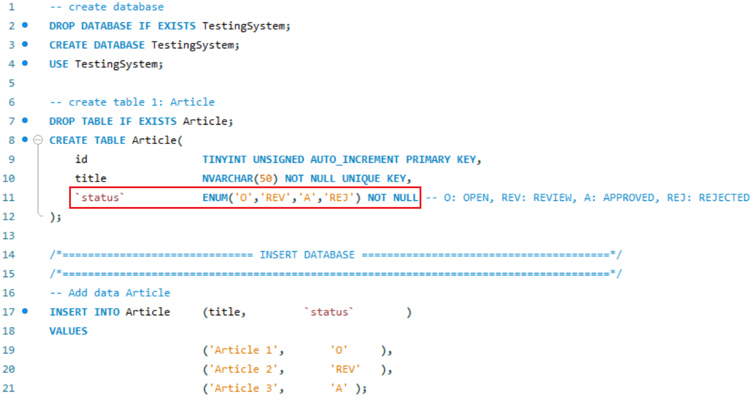
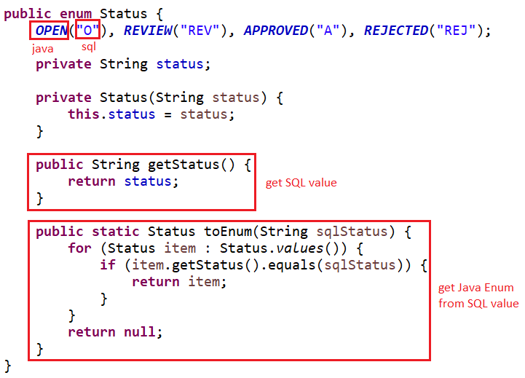
Enum
Enum

Slide 29
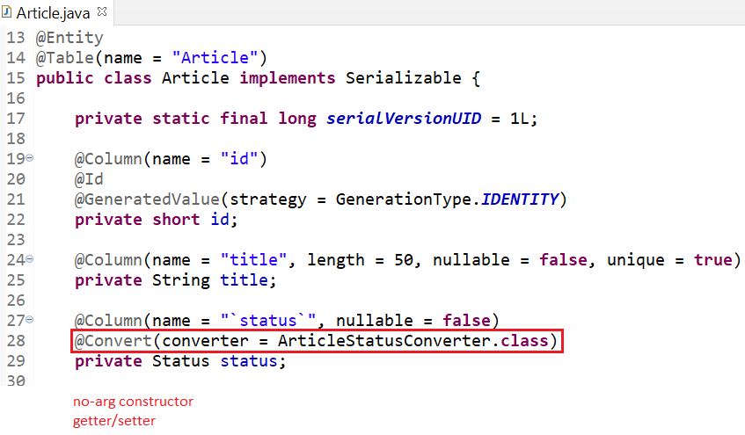
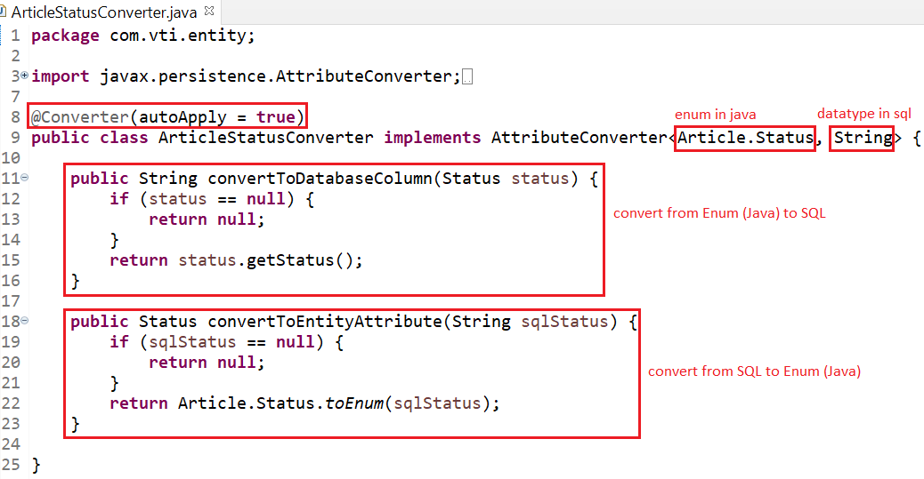
Enum
Entity
Converter File

Slide 30
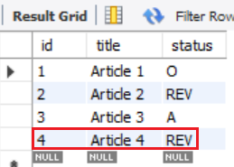
Enum
REVIEW (in Java) → REV (in SQL)

Slide 31
Generator
@GeneratedValue(strategy, generator)
  GenerationType.IDENTITY
  GenerationType.SEQUENCE
  GenerationType.AUTO (default)
  Custom Generator

Slide 32
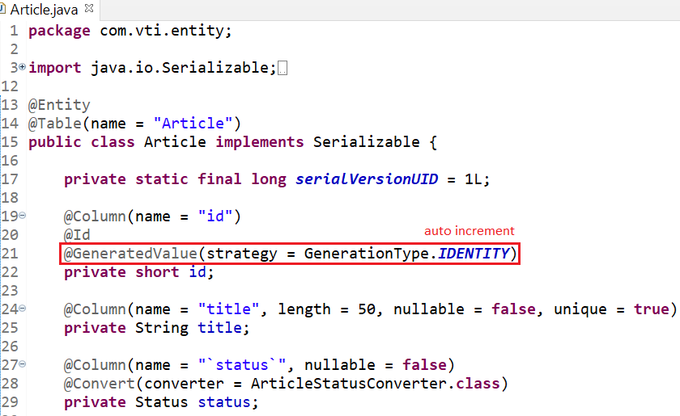
Generator
GenerationType.IDENTITY: auto increment

Slide 33
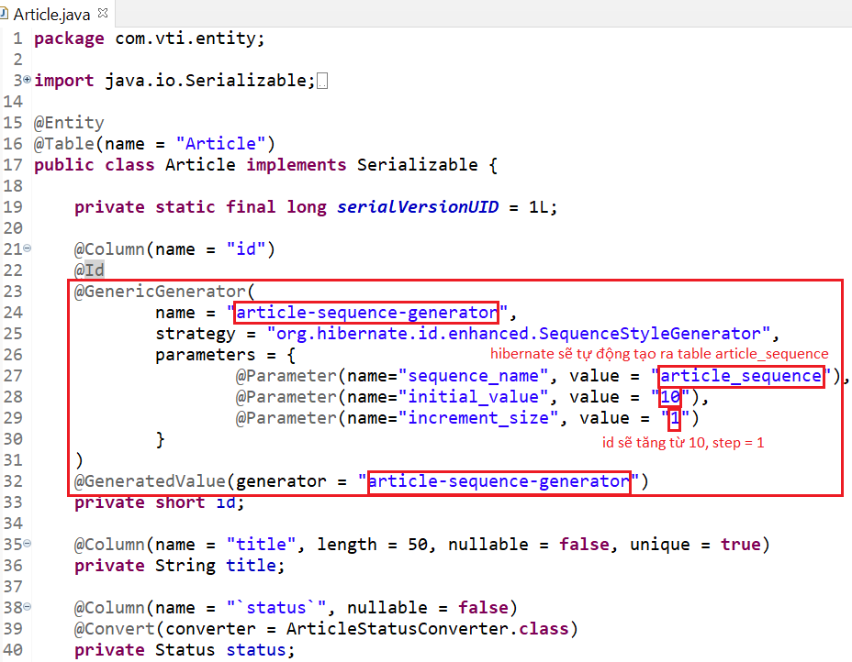
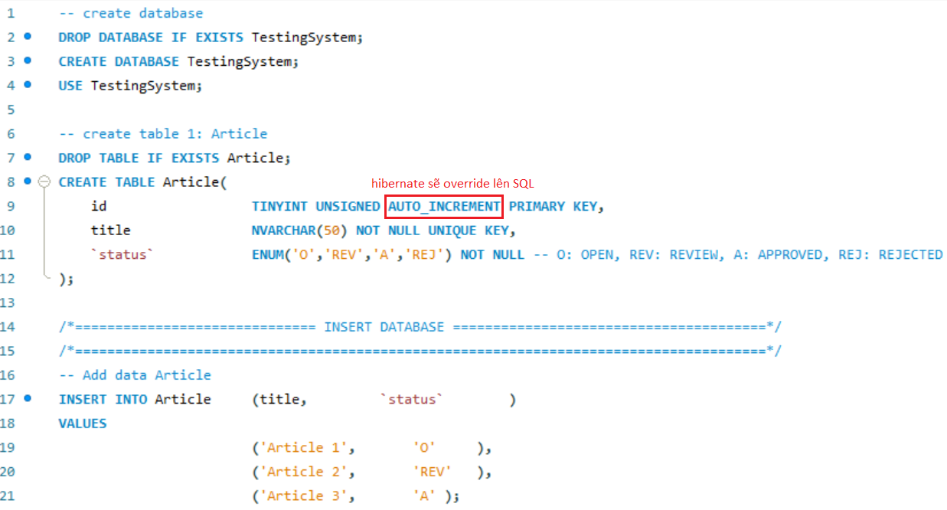
Generator
GenerationType.SEQUENCE: The id will increase sequentially
Entity

Slide 34
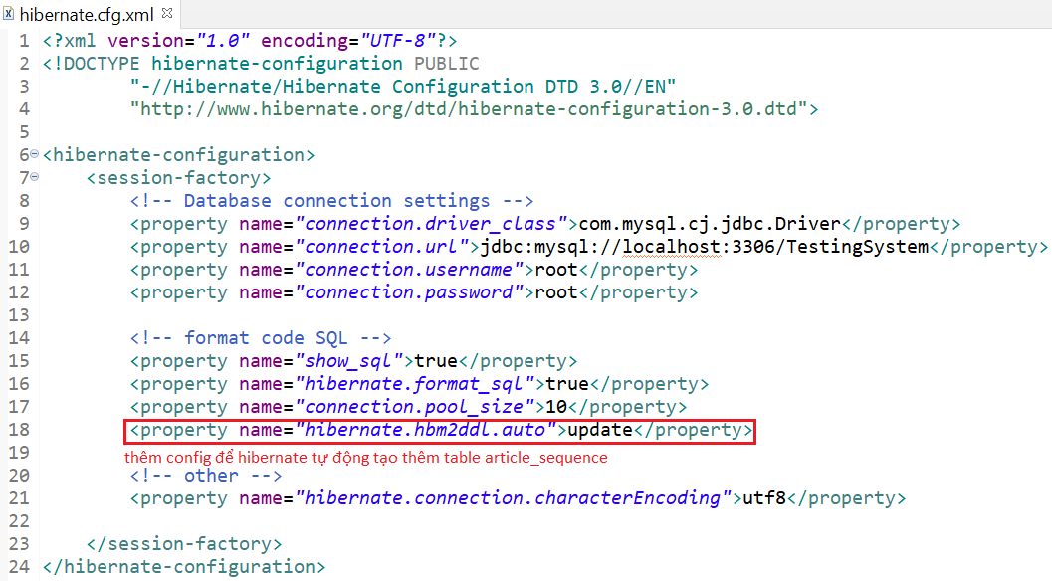
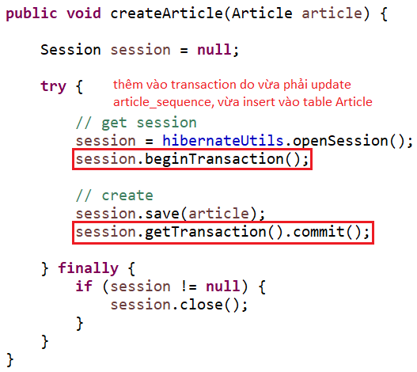
Generator
Config
Repository

Slide 35
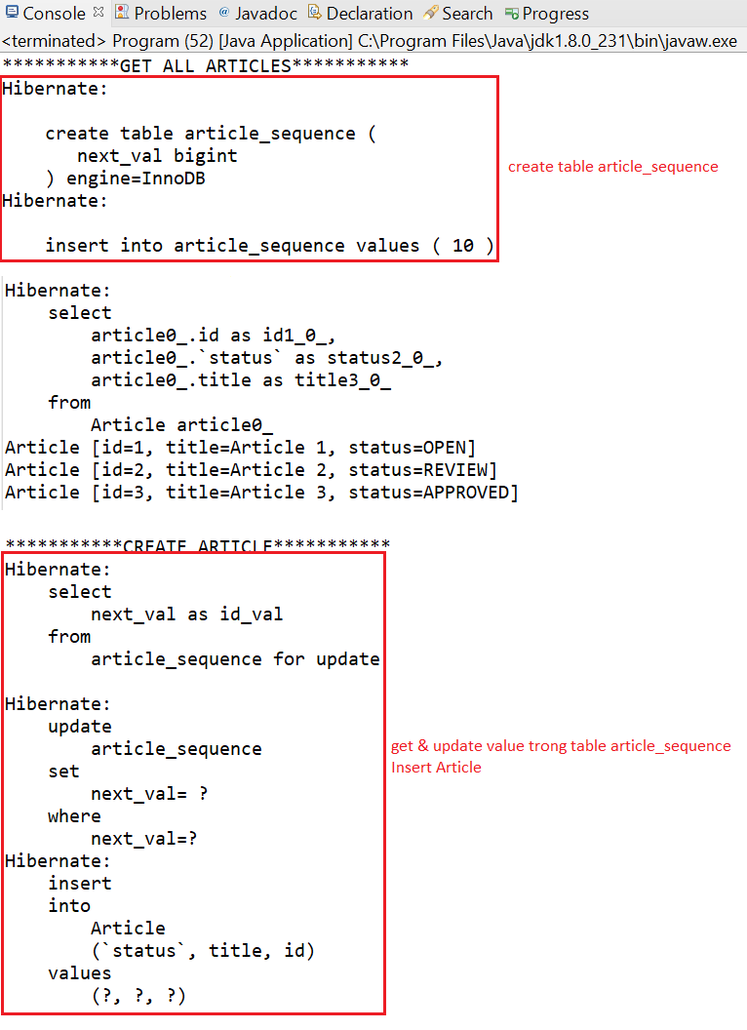
Generator

Slide 36
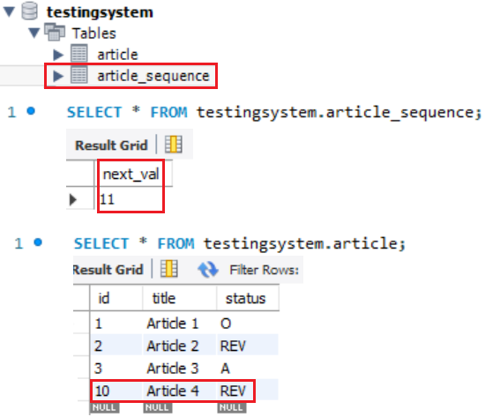
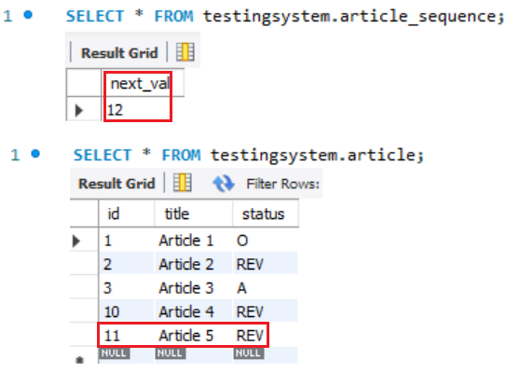
Generator
Primary key generation will start at 10 with step = 1

Slide 37
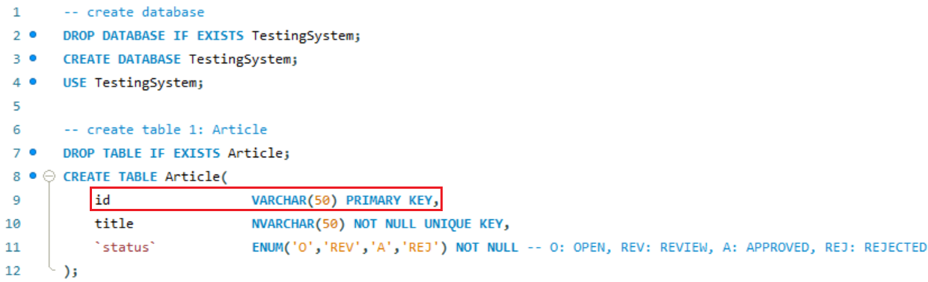
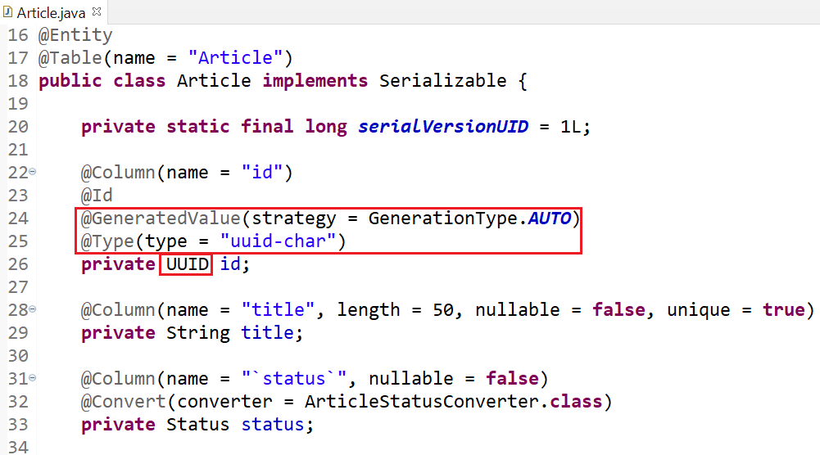
Generator
GenerationType.AUTO (default): The id will generate UUID
Entity

Slide 38
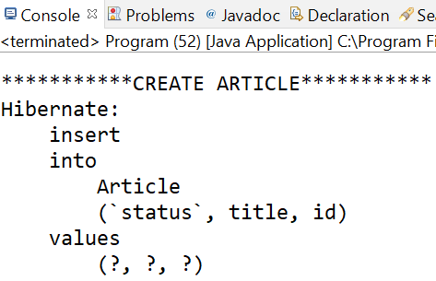
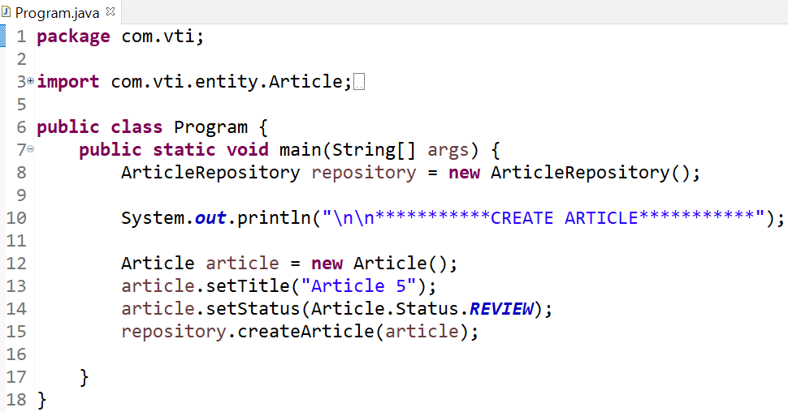

Generator

Slide 39

Generator
UUID using for id application, token for reset password, ...

Slide 40


Generator
Custom generator
Generator file

Slide 41


Generator
Entity
Repository

Slide 42


Generator
code = type-count

Slide 43
Primary key
Single primary key
Multiple primary key
  Way 1: @Embeddable & @EmbeddedId
  Way 2: @Embeddable & @IdClass

Slide 44

Primary key
Single primary key
    @Id: Define single id of database’s table

Slide 45

Primary key
Multiple primary key
  Way 1: @Embeddable & @EmbeddedId

Slide 46


Primary key
Primary key Class
Using

Slide 47


Primary key

Slide 48

Primary key
Multiple primary key
  Way 2: @Embeddable & @IdClass
Primary key Class (Similar to Way 1)
Using

Slide 49

Primary key

Slide 50
Q & A
Copyright © VTI Academy All Rights Reserved

